Slide 1
WHAT IS THERMODYNAMICS?
Thermo means Heat
Dynamics means motion under the action of force
Thermodynamics is the branch of science dealing with heat or work (Broadly energy interaction) and related changes in the physical properties of substance.

Slide 2
Applications of Engineering Thermodynamics
Engineering application of thermodynamic principles is the design of various systems using fluid properties to cause energy transformation
Applications in design of heat engines, refrigeration machines, air conditioning systems

Slide 3
Scope of Thermodynamics
It is limited to macroscopic properties of matter i.e. properties of large number of particles of systems
It considers the initial and final states of a system and not the mechanism of the process

Slide 4
Macroscopic Vs. microscopic approach
Macroscopic
A quantity of matter is taken into account for analysis .It does not consider matter at molecular level.
This kind of approach is made in classical thermodynamics.
Microscopic
In this approach analysis is done on molecular level. By adding up the behavior of each molecule analysis can be done.
This kind of approach is made in Statistical thermodynamics.

Slide 5
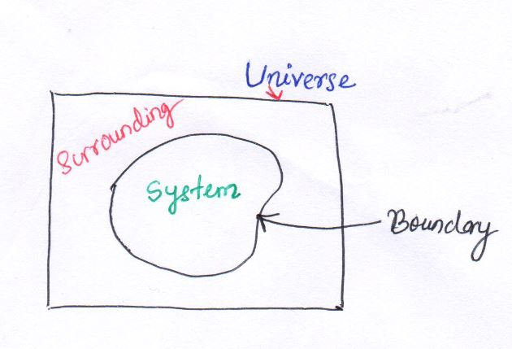
System- A thermodynamic system is defined as the quantity of matter or a region in space upon which attention is concentrated in the analysis of a problem. Here quantity of matter may be gas, solid or liquid, magnetic field, electric field or even photons.
Surrounding-Everything external to the system is surrounding
Universe-System and surrounding together constitute Universe.
Boundary-System and surrounding is separated by Boundary.
Boundary can be 1.Fixed(gas inside a rigid box)2.Movable (piston cylinder arrangement)

Slide 6
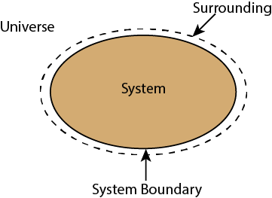

Slide 7
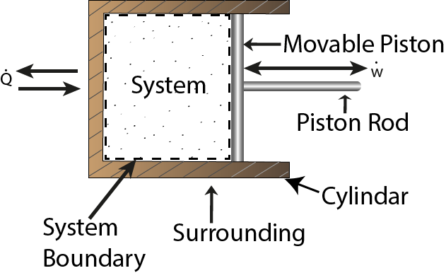
Closed system-in which no mass is permitted to cross the system boundary i.e. we would always consider a system of constant mass. We won’t permit heat and work to enter or leave but not mass.
No mass entry or exit

Slide 8
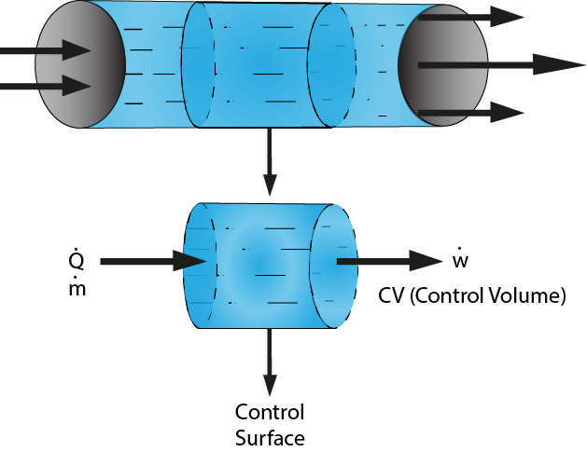
Open system-in which we permit mass to cross the system boundary in either direction (from the system to surroundings or vice versa).In analysing open systems, we typically look at a specified region of space, and observe what happens at the boundaries of that region.
Most of the engineering devices are open system.

Slide 9
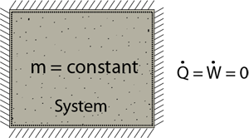
Isolated System-in which there is no interaction between system and the surroundings. It is of fixed mass and energy, and hence there is no mass and energy transfer across the system boundary.
Example: Universe
No Heat and Mass Entry or Exit

Slide 10
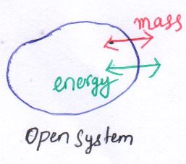
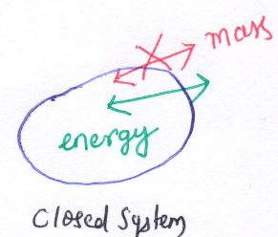
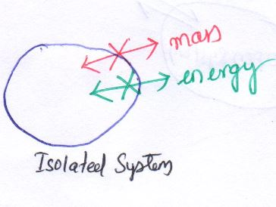
Types of system
Open system
Both mass and energy can cross the boundary
e.g. Pump, compressor, turbine, Heat exchanger
Closed system
Only energy can cross the boundary
Isolated system
No transfer of energy and matter across the boundary
e.g. Thermo flask, universe
e.g. Refrigerator, AC

Slide 11
Control volume & Control surface
Control volume: Certain fixed region or volume in space surrounding system.
Control surface: The surface of control volume.

Slide 12
Thermodynamic properties
Properties are used to define the characteristics of a system.
E.g. Pressure , Temperature, volume, mass
Thermodynamics properties are mainly divided into 2 classes
1.Extensive Properties-Properties are dependent on mass . e.g. volume, energy, enthalpy
2.Intensive Properties-Properties are independent of mass . e.g. Pressure, Temperature , density
All specific properties are intensive properties.

Slide 13
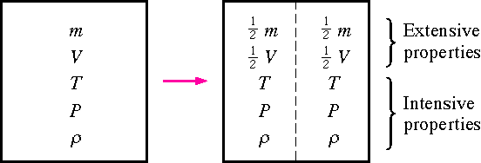
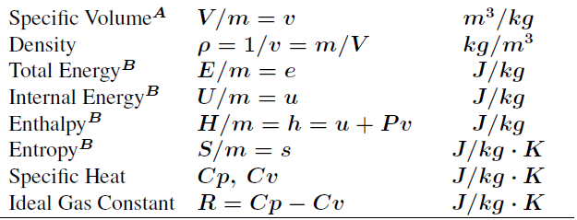
Specific properties – The ratio of any extensive property of a system to that of the mass of the system is called an average specific value of that property (also known as intensives property)

Slide 14
States-conditions of a system described by its properties
Process-when system changes from one state to another then It is called a Process.
Reversible Process-A process when reversed does not leave any effect on system and surrounding or it can goes back to its original state.
Irreversible Process-A process which cannot be reversed to its original state
Cycle-Sequence of different processes whose initial and final states are same.

Slide 15
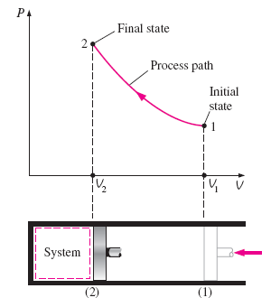
State, path, Process

Slide 16
Point function & path function
Point function
Properties whose value depends on end states
exact or perfect differentials
Path function
Properties whose value depend on path
Inexact differentials
e.g. Pressure, Temperature , Volume
e.g. Work , Heat

Slide 17
Path and Point Function
Path function It depend on path followed during a process as well as end states. (i.e. Work &heat)
Point function It depend on the state only. (i.e. V, P &T)
From diagram, since the area under each curve represents the work of each process, the amount of work involved in each case is not a function of the end states of process, and it depends on the path the system follows in going from state 1 to state 2.For this reason work is called path function and thermodynamic properties are called point function.

Slide 18
Heat & Work
Thermodynamic definition of work:
Positive work is done by a system when the sole effect external to the system could be reduced to the rise of a weight.
Thermodynamic definition of heat:
It is the energy in transition between the system and the surroundings by virtue of the difference in temperature.
Work is the form of energy useful in displacement of a body
dW= F.dL= p. A dL= p.dV
Heat is the form of energy transferred due to temperature gradient between two bodies

Slide 19
Sign Conventions
Work done by the system is +ve
Obviously work done on the system is –ve
Heat given to the system is +ve
Obviously Heat rejected by the system is -ve

Slide 20
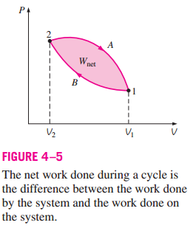
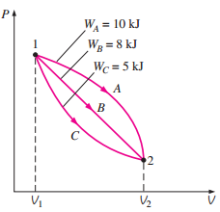


Work is a path function and inexact differential.
Inexact differential

Slide 21
Closed system → System Interact with surroundings → Work transfer → Heat transfer
Work (Closed system)
Energy transferred without mass cross the boundary, only due to intensive property difference other than temperature → not be stored on a system

Slide 22
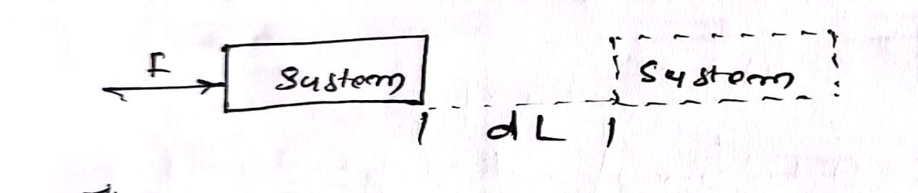
Mechanics Definition
Work done by SYSTEM IS a force acts upon a body moving in the direction of force

Slide 23
Thermodynamic point view:
In thermodynamics, work transfer is considered as occurring between system and surroundings
Work is said to be done by the system, if the sole effect on things external to the system can be reduced to the raising the weight

Slide 24
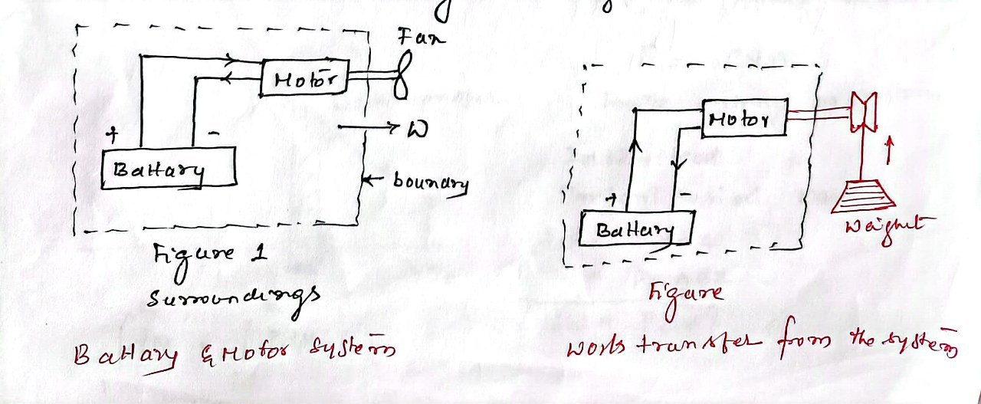

Slide 25
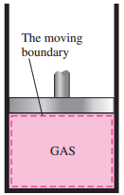
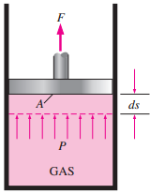
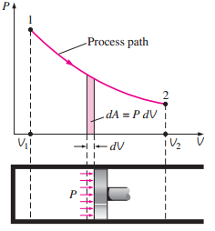
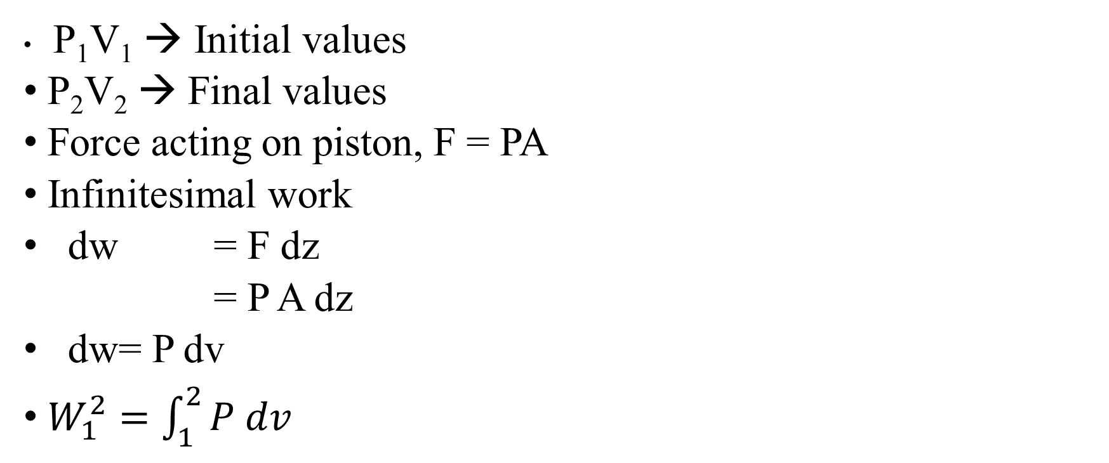
Displacement wWork done during Quasi – static process and Work:
P₁V₁→ Initial values
P₂V₂→ Final values
Force acting on piston, F = PA
Infinitesimal work
dw = F dz
= P A dz
dw = P dv
$W_{1}^{2}=\int_{1}^{2}{P dv}$

Slide 26
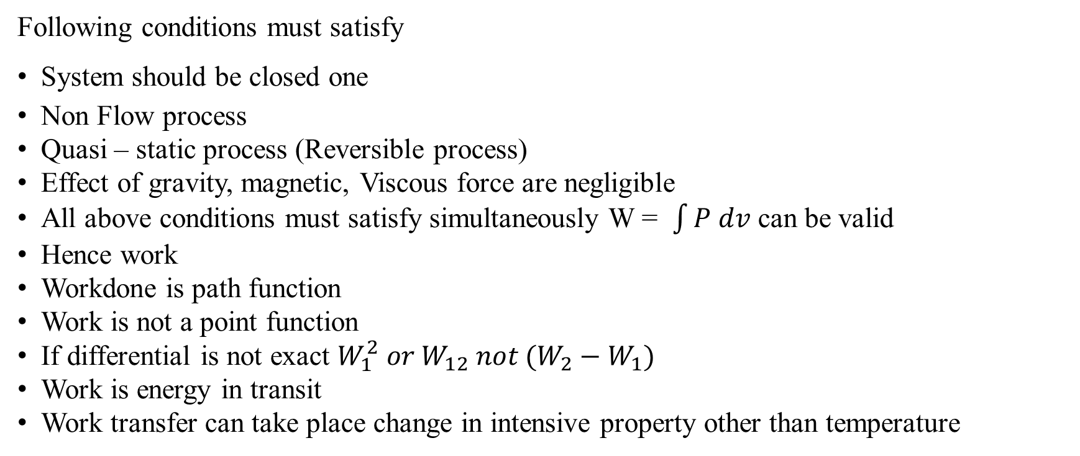
Limitations of integral P dv
Following conditions must satisfy
System should be closed one
Non Flow process
Quasi – static process (Reversible process)
Effect of gravity, magnetic, Viscous force are negligible
All above conditions must satisfy simultaneously W = $\int{P dv}$ can be valid
Hence work
Workdone is path function
Work is not a point function
If differential is not exact $W_{1}^{2} or W_{12} not (W_{2}−W_{1})$
Work is energy in transit
Work transfer can take place change in intensive property other than temperature

Slide 27
Mechanical Work Transfer
Displacement PdV work
Paddle Wheel work
Flow Work
Shaft Work

Slide 28
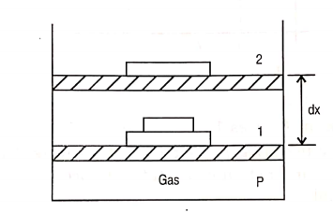
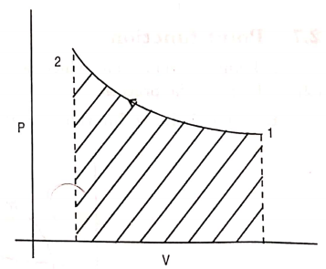
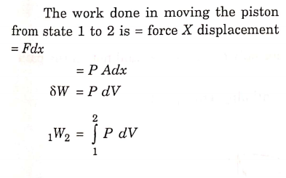
Displacement PdV work

Slide 29
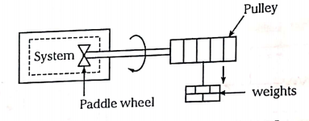

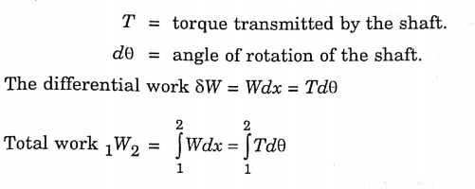
Paddle Wheel work

Slide 30
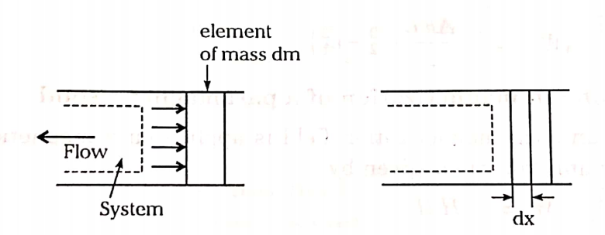
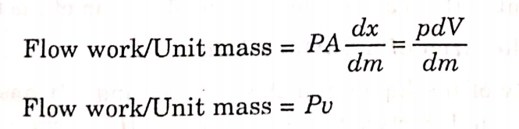
Flow Work

Slide 31
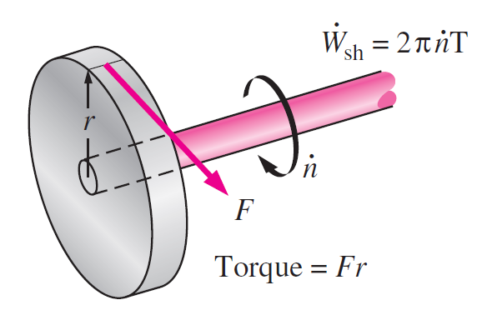
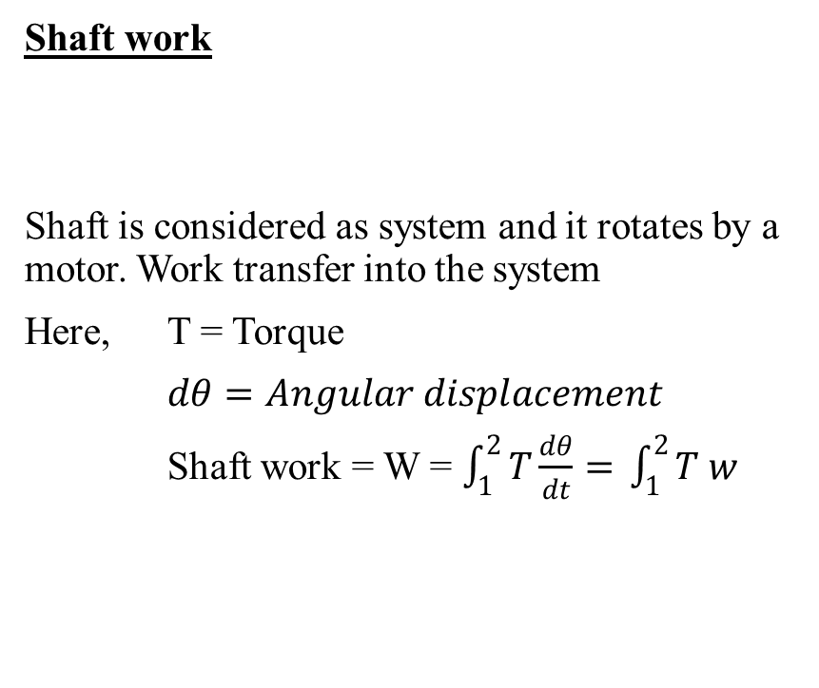
Shaft Work

Slide 32

Forms of Work
Displacement work Closed system
Peddle wheel work
Shaft work Open system
Flow work
Work is a path function
Closed system
Change state from 1 to 2
a & b are paths between 1 to 2
Work in 1 – a – 2
$$W_{1−a−2}=a\int_{1}^{2}{P dv}$$
Work transfer in 1 – b – 2
$$W_{1−b−2}=b\int_{1}^{2}{P dv}$$
Since below 1 – a – 2 is not equal to 1 – b – 2
Work transfer depends on path. Therefore, work is a path function

Slide 33
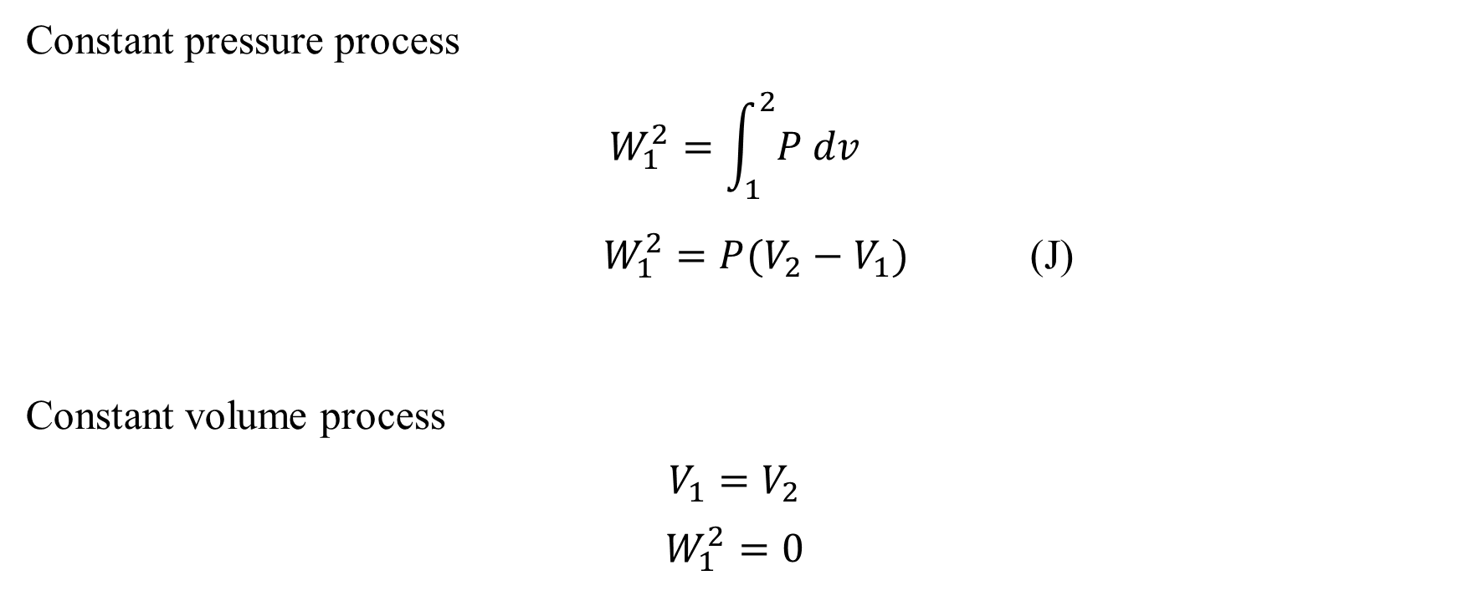
P dv work in various Thermodynamic process (Reversible)
Constant pressure process
$$W_{1}^{2}=\int_{1}^{2}{P dv}$$
$W_{1}^{2}=P(V_{2}−V_{1})$ (J)
Constant volume process
$$V_{1}=V_{2}$$
$$W_{1}^{2}=0$$

Slide 34
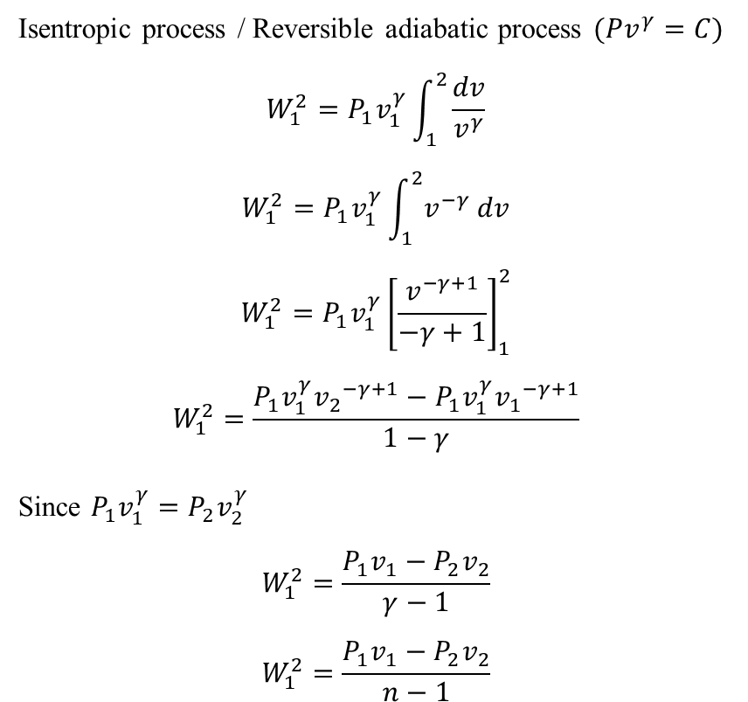
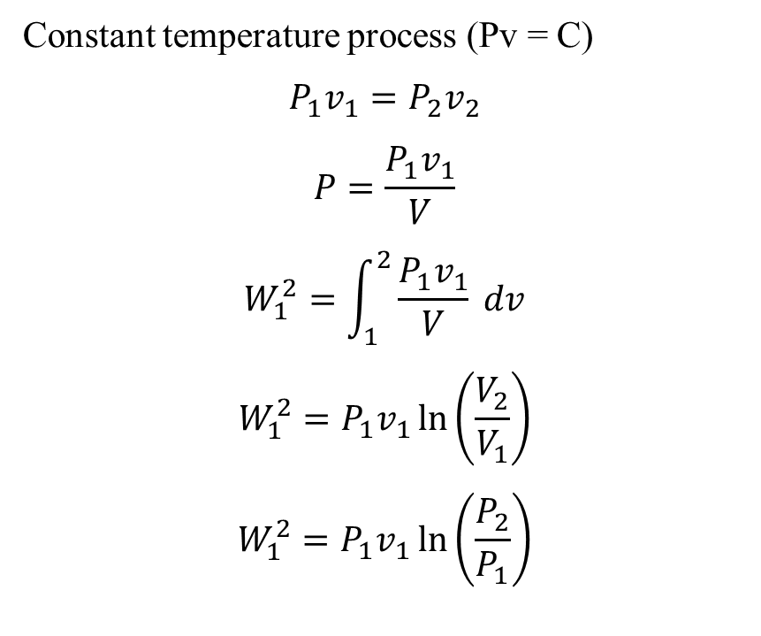
P dv work in various Thermodynamic process (Reversible)
Constant temperature process (Pv = C)
$$P_{1}v_{1}=P_{2}v_{2}$$
$$P=\frac{P_{1}v_{1}}{V}$$
$$W_{1}^{2}=\int_{1}^{2}{\frac{P_{1}v_{1}}{V} dv}$$
$$W_{1}^{2}=P_{1}v_{1}\ln\left(\frac{V_{2}}{V_{1}}\right)$$
$$W_{1}^{2}=P_{1}v_{1}\ln\left(\frac{P_{2}}{P_{1}}\right)$$
Isentropic process / Reversible adiabatic process $(Pv^{γ}=C)$
$$W_{1}^{2}=P_{1}v_{1}^{γ}\int_{1}^{2}{\frac{dv}{v^{γ}}}$$
$$W_{1}^{2}=P_{1}v_{1}^{γ}\int_{1}^{2}{v^{−γ} dv}$$
$$W_{1}^{2}=P_{1}v_{1}^{γ}{\left[\frac{v^{−γ+1}}{−γ+1}\right]}_{1}^{2}$$
$$W_{1}^{2}=\frac{P_{1}v_{1}^{γ}{v_{2}}^{−γ+1}−P_{1}v_{1}^{γ}{v_{1}}^{−γ+1}}{1−γ}$$
Since $P_{1}v_{1}^{γ}=P_{2}v_{2}^{γ}$
$$W_{1}^{2}=\frac{P_{1}v_{1}−P_{2}v_{2}}{γ−1}$$
$$W_{1}^{2}=\frac{P_{1}v_{1}−P_{2}v_{2}}{n−1}$$

Slide 35
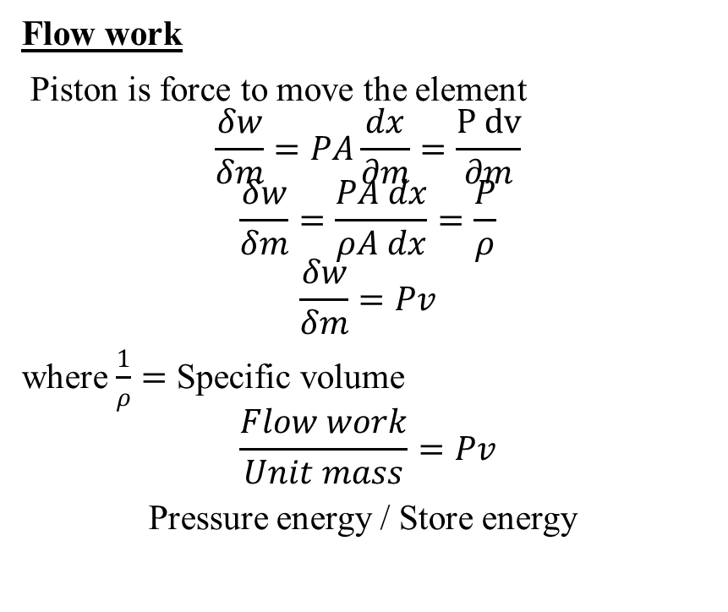
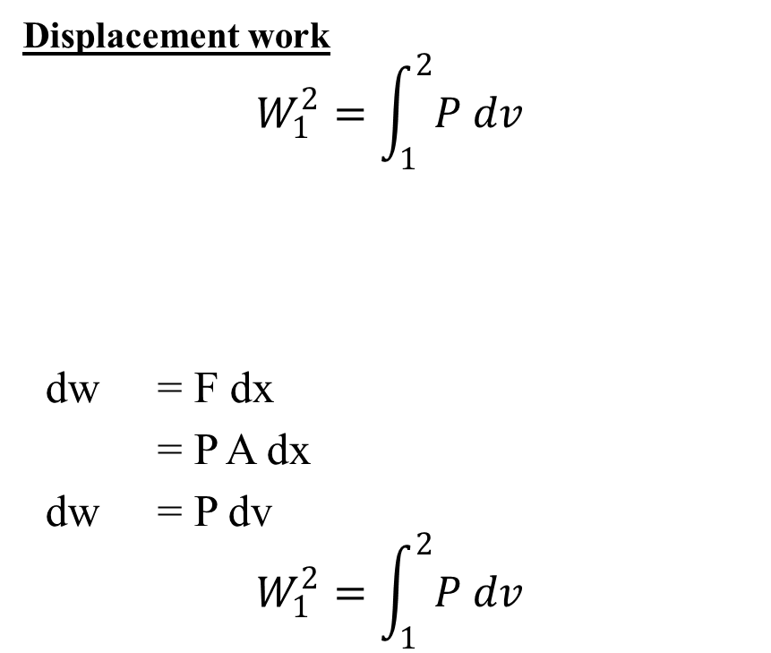
Displacement work
$$W_{1}^{2}=\int_{1}^{2}{P dv}$$
dw = F dx
= P A dx
dw = P dv
$$W_{1}^{2}=\int_{1}^{2}{P dv}$$
Flow work
Piston is force to move the element
$$\frac{δw}{δm}=PA\frac{dx}{∂m}=\frac{P dv}{∂m}$$
$$\frac{δw}{δm}=\frac{PA dx}{ρA dx}=\frac{P}{ρ}$$
$$\frac{δw}{δm}=Pv$$
where $\frac{1}{ρ}=$ Specific volume
$$\frac{Flow work}{Unit mass}=Pv$$
Pressure energy / Store energy

Slide 36
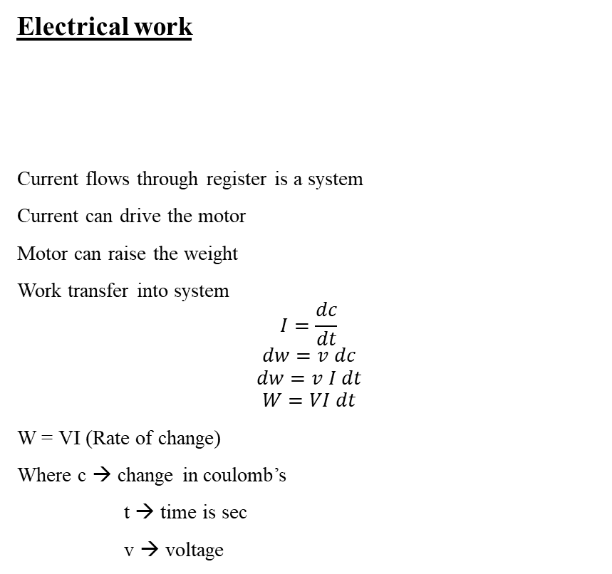
Electrical work
Current flows through register is a system
Current can drive the motor
Motor can raise the weight
Work transfer into system
$$I=\frac{dc}{dt}$$
$$dw=v dc$$
$$dw=v I dt$$
$$W=VI dt$$
W = VI (Rate of change)
Where c → change in coulomb’s
t → time is sec
v → voltage
Shaft work
Shaft is considered as system and it rotates by a motor. Work transfer into the system
Here, T = Torque
$dθ=Angular displacement$
Shaft work = W = $\int_{1}^{2}{T\frac{dθ}{dt}=} \int_{1}^{2}{T w}$

Slide 37
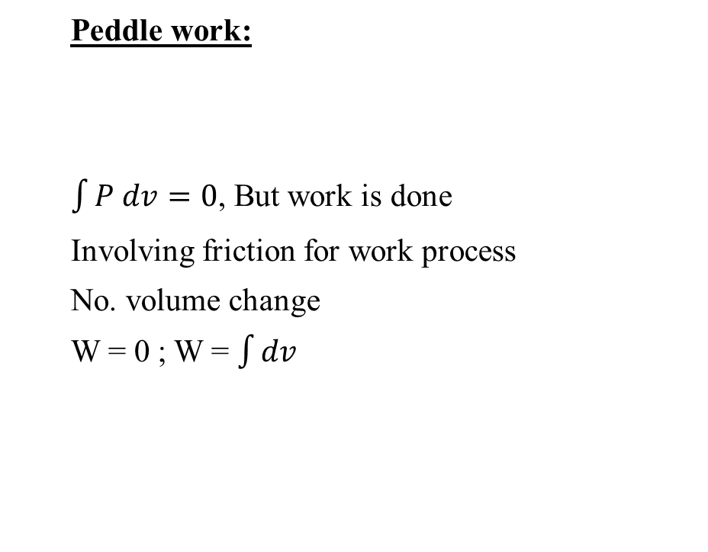
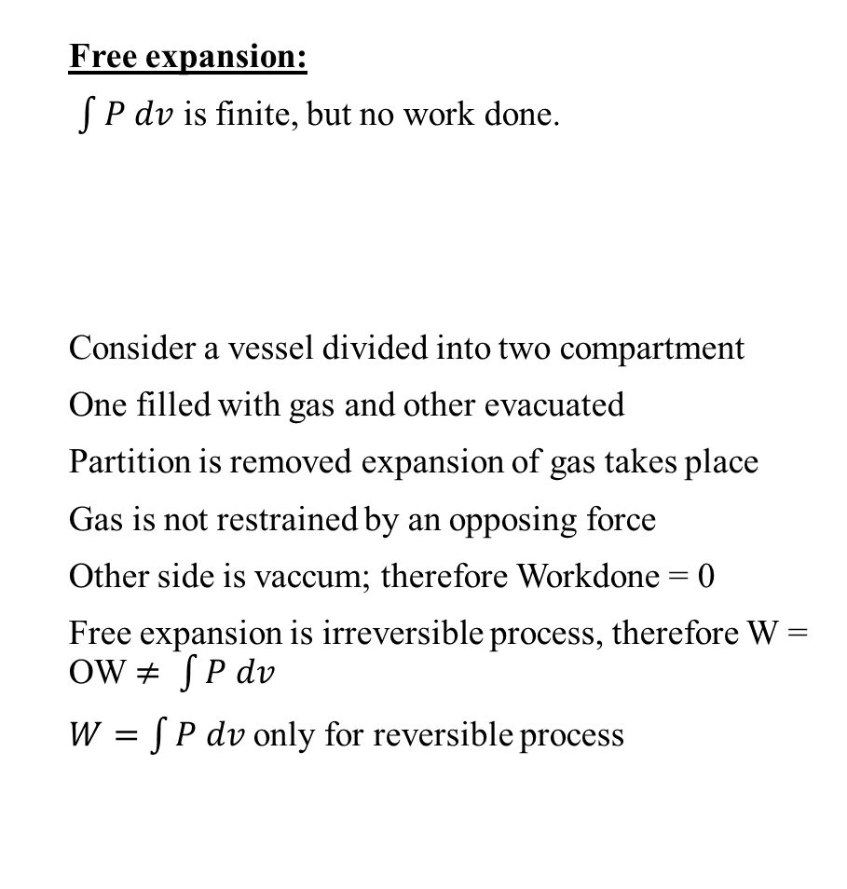
Free expansion:
$\int{P dv}$ is finite, but no work done.
Consider a vessel divided into two compartment
One filled with gas and other evacuated
Partition is removed expansion of gas takes place
Gas is not restrained by an opposing force
Other side is vaccum; therefore Workdone = 0
Free expansion is irreversible process, therefore W = OW $≠ \int{P dv}$
$W=\int{P dv}$only for reversible process
Peddle work:
$\int{P dv}=0$, But work is done
Involving friction for work process
No. volume change
W = 0 ; W = $\int{dv}$

Slide 38
Heat
Mode of energy transfer, which cannot be accounted as work from Macroscopic point of view is called Heat.
Energy transfer by virtue of temperature difference across the boundary of the system
Heat is not property system
Heat is energy in transit
Its difference is in exact

Slide 39
Heat
Mode of energy transfer, which cannot be accounted as work from Macroscopic point of view is called Heat.
Energy transfer by virtue of temperature difference across the boundary of the system
Heat is not property system
Heat is energy in transit
Its difference is in exact
Sign convection
Expansion → + ve
Compression → - ve
Heating → + ve
Cooling → - ve

Slide 40
Similarities between Heat and Work
Difference between Heat and Work
Both are Transient phenomena
System never possess Heat and work
May occur when the system undergoes a change of state.
Both are boundary phenomena
Both are path functions
Both are in exact differentials.
Work can be converted 100% into heat
Heat cannot be converted 100% into work
Their sign convection are opposite
Heat is low grade & work is high energy
Heat transfer due to temperature difference
Work transfer due to other than temperature difference

Slide 41
Thermodynamic equilibrium
A system is said to be in thermodynamic equilibrium if it satisfies the following three conditions
Thermal Equilibrium-No temperature difference between system and surrounding
Mechanical equilibrium-no unbalanced forces within the system or with the surrounding
Chemical equilibrium-no chemical reaction and no change in chemical composition

Slide 42
Quasi-static Process
Quasi-static Process: The very slow process consists of many equilibrium states. Ideal process.
A quasi-static process is one in which
The deviation from thermodynamic equilibrium is infinitesimal.
All states of the system passes through are equilibrium states.

Slide 43
If we remove the weights slowly one by one the pressure of the gas will displace the piston gradually. It is quasi-static.
On the other hand if we remove all the weights at once the piston will be kicked up by the gas pressure.(This is unrestrained expansion) but we don’t consider that the work is done -because it is not in a sustained manner
In both cases the systems have undergone a change of state.
Another eg: if a person climbs down a ladder from roof to ground, it is a quasi-static process. On the other hand if he jumps then it is not a quasi-static process.

Slide 44
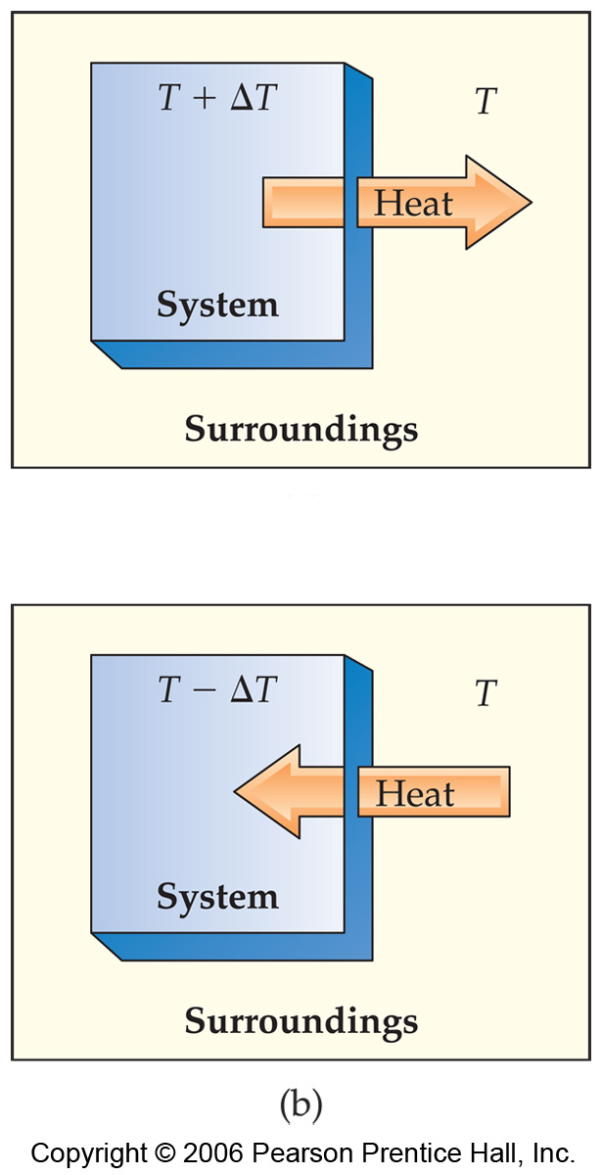
Reversible & Irreversible process
Reversible Process The process having the same path (traces of states) travel while reversed. Both the system and the surroundings may be restored to their initial states, without effect in the rest of universe.
In a reversible process the system changes in such a way that the system and surroundings can be put back in their original states by exactly reversing the process.
Changes are infinitesimally small in a reversible process.

Slide 45
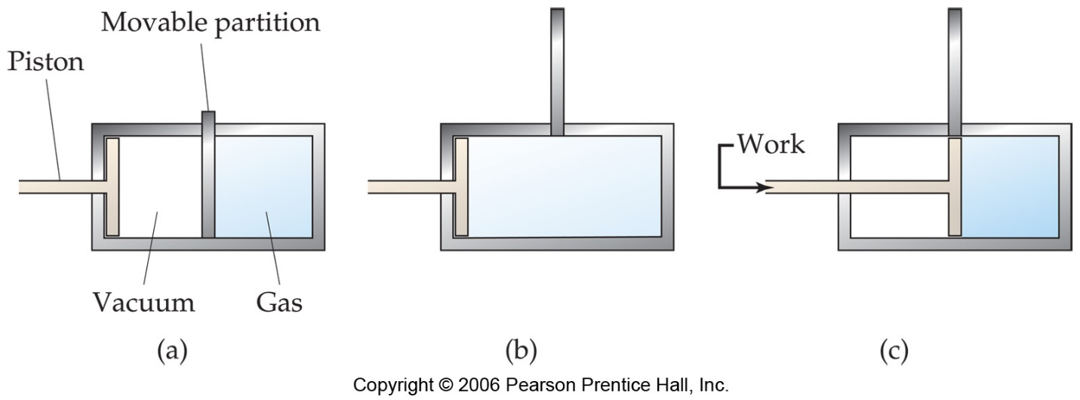
Irreversible Process Almost all the real or actual processes are irreversible. (Non-equilibrium). Energy Loss occurs during the real processes.
Irreversible processes cannot be undone by exactly reversing the change to the system.
All Spontaneous processes are irreversible.
All Real processes are irreversible.

Slide 46
Temperature
Thermodynamics – science of temperature
Temperature – is associated with ability to differentiate the hot from cold.
Thermal equilibrium – When two bodies at deferent temperature are brought into contact, some time later they attain a common temperature – now they are in thermal equilibrium.

Slide 47
Zeroth law of Thermodynamics
Base for all temperature measurement.
Thermal equilibrium is the key word for zeroth law.
Definition: When a body A is in thermal equilibrium with a body B, and also separately with a body C, then B and C will be in thermal equilibrium with each other

Slide 48
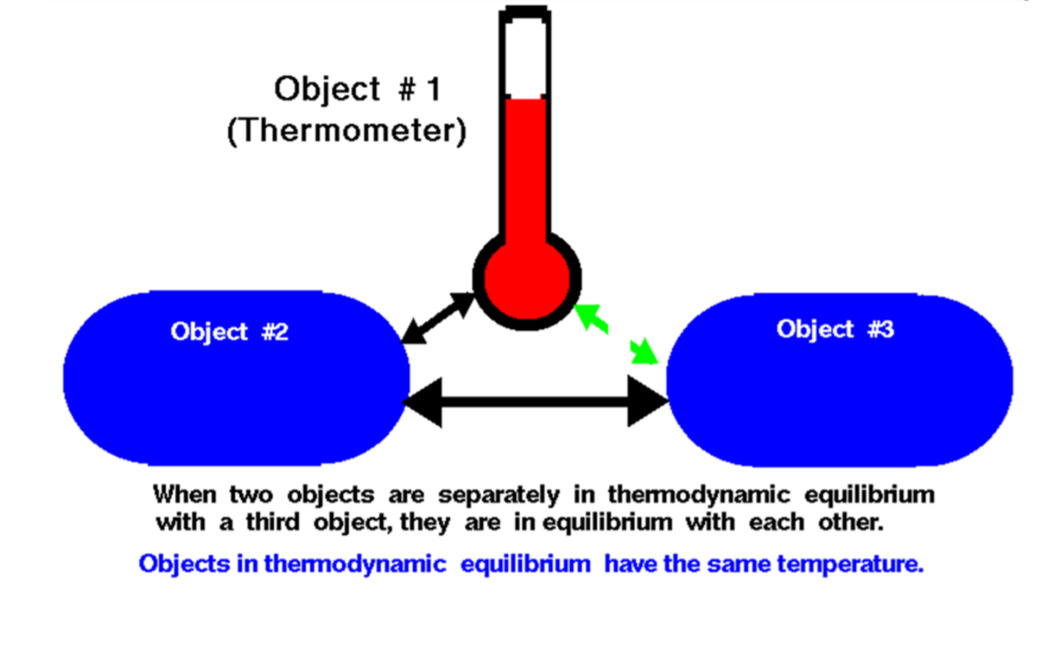
Thermodynamic Equillibirium

Slide 49
Temperature Scales
All temperature scales are based on some easily reproducible states such as the freezing and boiling points of water, which are also called the ice point and the steam point
Celsius Temperature Scale
Fahrenheit scale
Kelvin scale

Slide 50
Celsius Temperature Scale
The Celsius temperature scale employs a degree of the same magnitude as that of the ideal gas scale, but its zero point is shifted, so that the Celsius temperature of the triple point of water is 0.01 degree Celsius or 0.01°C. If t denotes the Celsius temperature,
then t = T- 273.15
Thus the Celsius temperature ts at which steam condenses at I atm. pressure
ts = Ts - 273.15 = 373.15 - 273.15= 100.00°C
Similar measurements for ice points show this temperature on the Celsius scale to be 0.00°C. The only Celsius temperature which is fixed by definition is that of the triple point

Slide 51
Fahrenheit scale
the freezing point of water is 32 degrees Fahrenheit (°F) and the boiling point is 212 °F.
On the Celsius scale, the freezing and boiling points of water are 100 degrees apart. A temperature interval of 1 °F is equal to an interval of ​⁵⁄₉ degrees Celsius. The Fahrenheit and Celsius scales intersect at −40° (i.e., −40 °F = −40 °C).
f °Fahrenheit to c °Celsius : (f − 32) °F × 5°C/9°F = (f − 32)/1.8 °C = c °C

Slide 52
Kelvin Scale
The lower standard point on this scale is 273K and upper standard point is 373K. There 273 divisions below lower standard point. Its 0K is equal to -273ºC. To convert celsius temperature to kelvin temperature following formulas is used.
Temperature in Kelvin = Temperature in ºC + 273
For example, 30ºC = (30+273) = 303K
Conversely, (353-273) = 80ºC
To convert temperature from celsius scale to kelvin scale the value is increased numerically by 273. Therefore, the temperature on the kelvin scale and celsius scale are related to each other as follows.
T(K) = T(ºC) + 273
The celsius and the kelvin scales are used all over the world for scientific measurements. These scales are also found to be more convenient than the scales introduced by Fahrenheit and Reaumer which were commonly used till recently.
The following formula is used for the conversion between different temperature scales.
K-273/100 = C/100 = F-32/180 = R/80

